Slide 1
Intro and Rust
CS 1622
Jarrett Billingsley

Slide 2
Class announcements
be sure to check the notes on each of my slides
  for extra explanations, examples, snarky comments etc.
  as well as answers to the questions on the slides so you can study.
also, be sure to use Powerpoint to view my slides
  not Keynote, not Google Drive; they absolutely butcher alignment and diagrams and arrows and I use a lot of those. it’s bad enough that diagrams can become incorrect/misleading.
  if you use a note-taking app, open the pptx in Powerpoint and export it as PDF, then use that. it will look much better than opening the pptx directly in your note-taking app.
Notes:
- yahaha! you found me! I'm a slide note!

Slide 3
Administrivia

Slide 4
hi
you can just call me Jarrett
jarrett@cs.pitt.edu
sites.pitt.edu/~jfb42
Office hours: Mon/Wed 1:15-3:30 in 6509 SENSQ
Religious absences: contact me ASAP
Students with disabilities: contact the DRS ASAP
Everything in this section is also on my site in "course info"!
  I use red on the slides for really important things

Slide 5
Communication
I send announcements through Canvas which come thru email
  it is not my responsibility to make sure you get them, it’s yours
announcements/grades are the only things I use Canvas for
  (well recording class too)
  everything else is on my site.
  including the course schedule/syllabus.
Discord hours: most days after 12PM and before 9PM EDT
  but I don't really have a healthy work/life separation so
For more "official" communications, or if you need my attention immediately, use email.
  otherwise, Discord is preferred – much better for sharing code, screenshots, etc. in a much quicker way.

Slide 6
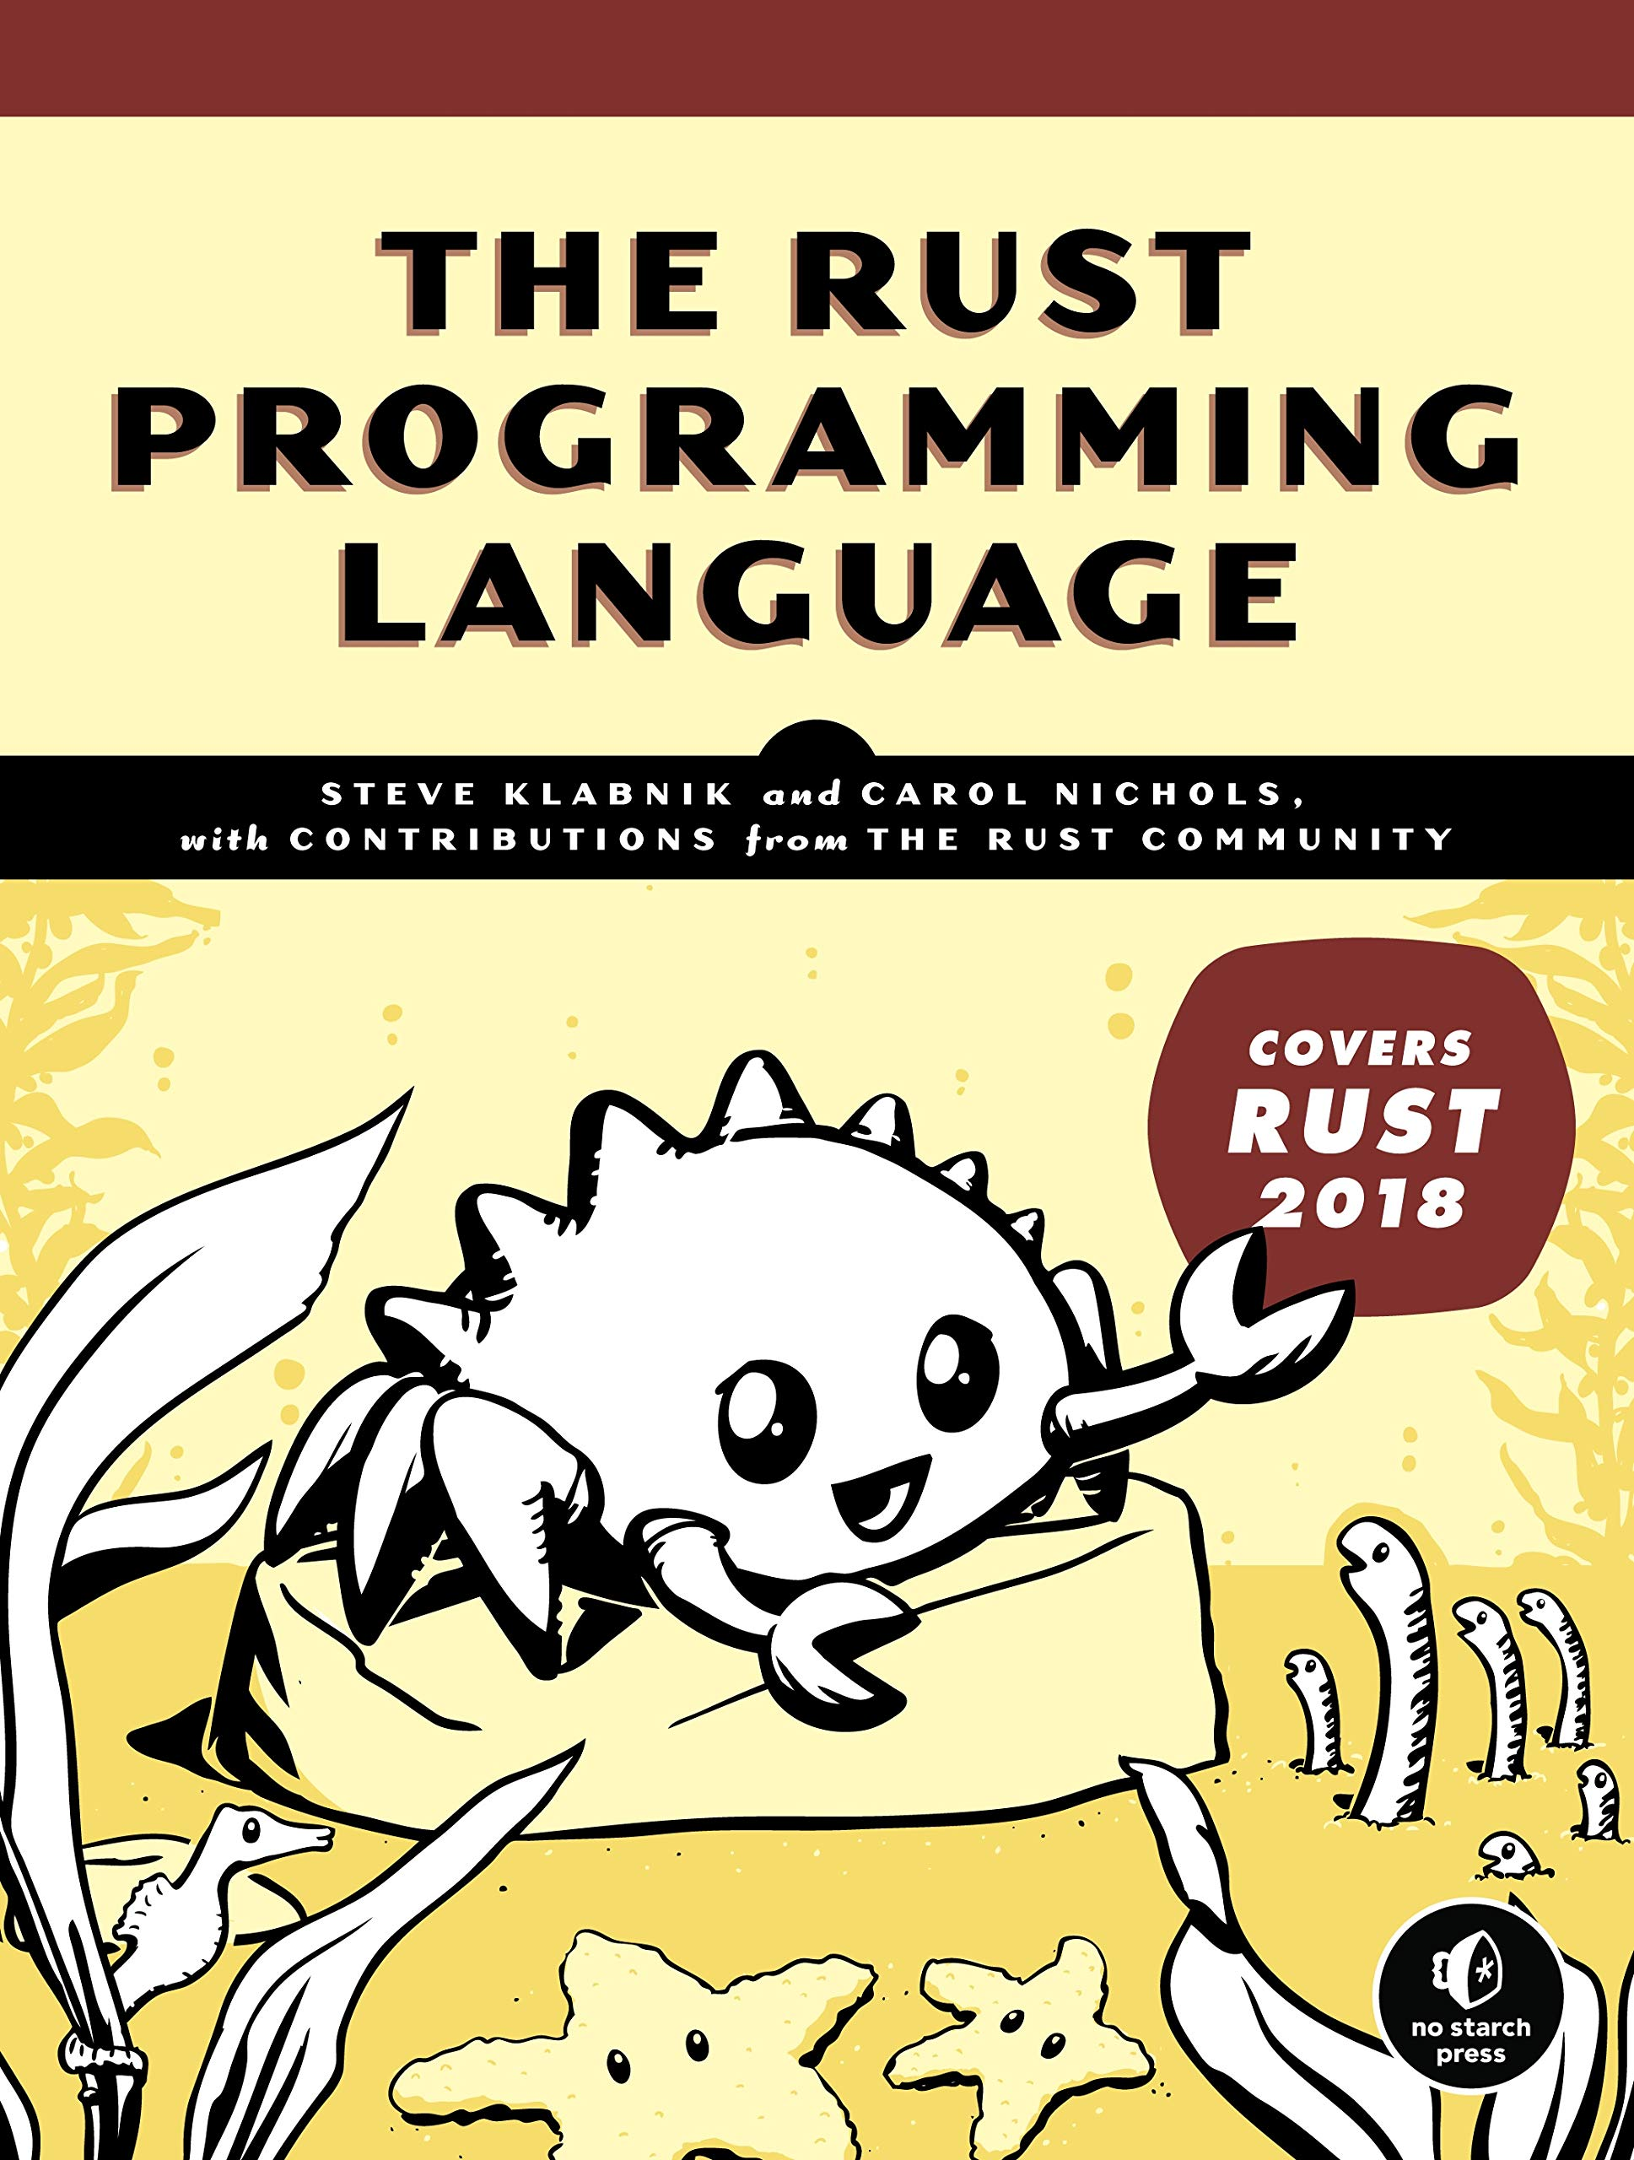
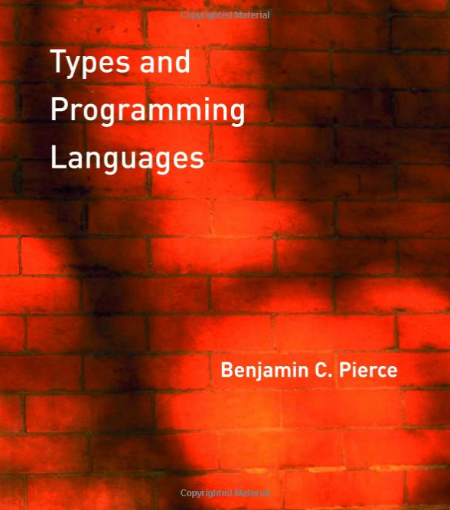
Textbooks???
I'm not really a book person.
none of these are required and the first two are free (see course info)
Notes:
- Rust book will definitely be useful to the vast majority of you, and it's free online
- also the first author (Steve Klabnik) is my FRIEND cause we were in pitt CS together so there
- the Thain book is the standard text for this course but eh
- TAPL is really good if you're interested in programming language and type theory

Slide 7
Grading
Projects (x4): 60%
  each is worth 15%
  there is a late submission policy, see the course info page
Exams (x2): 40%
  each worth 20%
  exam 2 is not cumulative! it’s just on the stuff after exam 1.
  on both exam days, we will do a short review session beforehand.
There are no labs or recitations or anything.
Attendance is not graded for lectures…
  but people who don't come and interact don't do well.

Slide 8
Teaching philosophy
I'm more of a "big picture" teacher
  I care about high-level concepts and problem-solving
  you won't get exam questions about function parameters
You are a student. you are supposed to be confused.
  I wanna help you understand!
  never say "this is a dumb question" cause there aren't any!
  DON’T STRUGGLE IN SILENCE!!!! EVER!!
What is a university setting good for today?
  focus, practice, and access to people who know stuff
  your friends do not know as much about this stuff as I do
  but also… your friends can be very helpful when studying or in practical matters (installing stuff etc)!
  studying together is not cheating! do it!

Slide 9
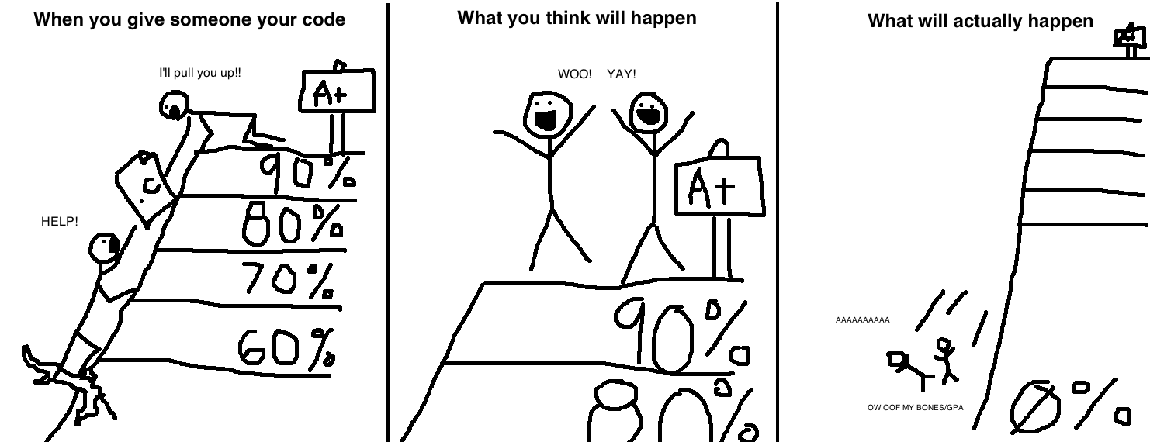
I can tell when you cheat :^)
If you cheat, you fail the course. Period.
Don't post your code on github, baidu etc.
Don't "help" your friends by giving them code.

Slide 10
Academic Integrity
If you "help" a friend, you are only delaying their failure until a later point when it will be too late to fix the problems.
  a 0 will hurt way, way more than a 60, and it'll hurt you both.
Don't cheat if your enrollment is contingent upon your GPA.
  or your ROTC or your student visa or your graduation or whatever.
Generally speaking, I trust you!
  I try to be accommodating about extensions and such
  I don’t think most cheaters are being lazy
But you’re an adult, and are responsible for your actions.
  I hate being in a position where I have your future in my hands…
  especially when you're the one who put it there.
  Do not take advantage of my trust.
If you're confused, don't cheat, ask for help. yes, even on the exams. yes, even an hour before the project is due.

Slide 11
Intro

Slide 12
What, Why, and How
for every topic, ask yourself (and me!) these questions:
Why do we use it?
"splitting code into functions makes it easier to read, understand, and reuse."
What is it?
"a function is a named piece of code."
"in Java, you write the return type, then the name, then a left parenthesis, then any arguments, with the type and name, separated by commas, then a right parenthesis, then…
How do we do it?
what and why are almost always more important than how.
on the exams, be sure you are answering the right question. if I ask "what is X," don't explain how to X.
Notes:
- it's so easy as an instructor to fall into the trap of explaining the How in tons of detail without giving any context.
- the "how" can have a million different answers. what's more important that you understand the ideas behind it.
[diagram: "why" is more abstract than "what", and "what" is more abstract than "how".]

Slide 13


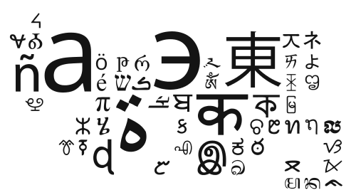


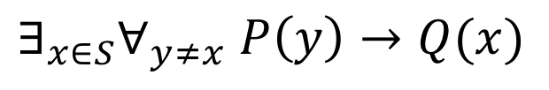
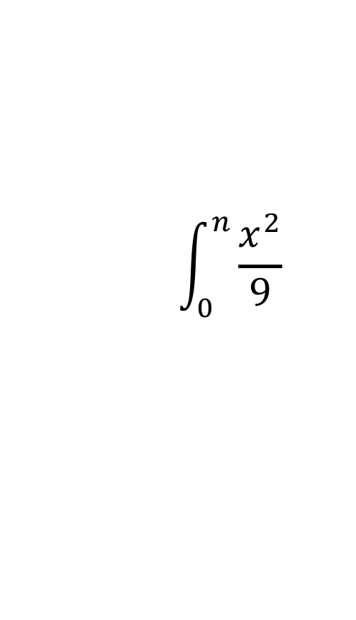
What is language?
a system of encoding information by using arbitrary symbols
  "symbols" can also include sounds, objects, actions, etc.
human languages are massively complex, like anything involving brains.
within the mess, there are kernels of mathematical and logical truth…
$$∃_{x∈S}∀_{y≠x} P\left(y\right)→Q(x)$$
$$\int_{0}^{n}{\frac{x^{2}}{9}}$$
…upon which computer languages were designed.
Notes:
- brains are weird meat computers that work in strange ways and anything they produce reflects their haphazard organization
[images: human languages include spoken, written, braille, signed, symbolic (road signs), mathematical, logical etc.]

Slide 14

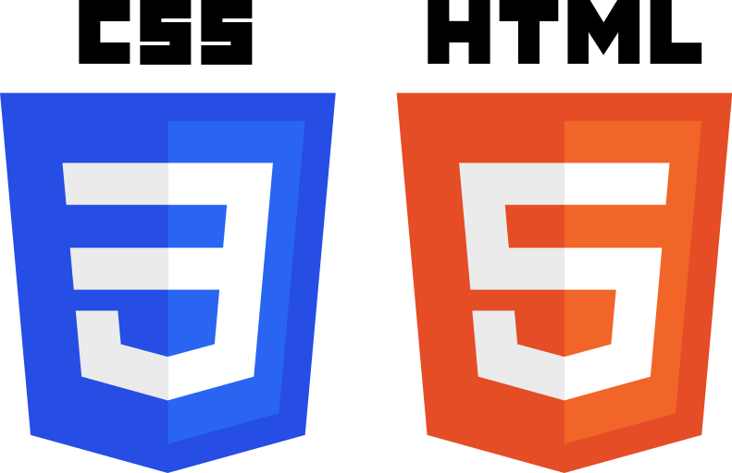

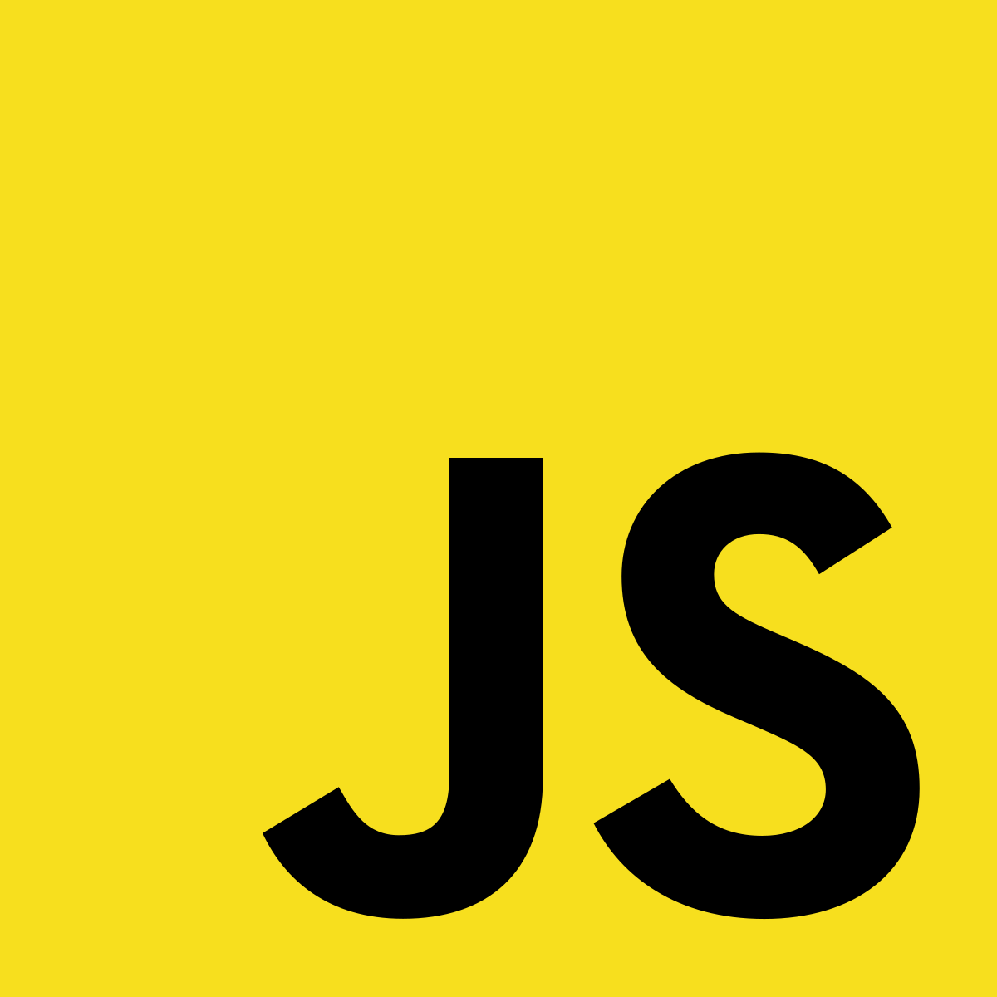



Computer languages
modeled after human languages, these are much simpler languages used to encode information in a way that is useful for computing.
declarative languages encode data and rules.
programming languages encode instructions for the computer to execute.
interchange and binary file formats encode domain- or application-specific data.
even things like network protocols are a kind of language!
Notes:
- all languages have common features (grammars, structure, meaningful "words" and so on) so many of the things we learn in this class will also apply, in part, to all of these languages.
[images: logos for programming languages, CSS, HTML, and some file types.]

Slide 15
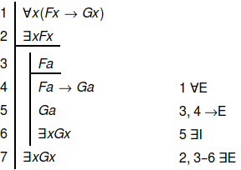
Programming languages
one definition is that programs are sequences of instructions…
but programs are also proofs.
fn main() {
for i in 0 .. 10 {
println!("i = {}", i);
}
}
the Curry-Howard correspondence shows that programs and proofs are two ways of expressing the same mathematical objects.
there are proof languages and proof assistants which can function as both programming languages and proof checkers.
Notes:
- this is some heavy shit and we're not going to get into it too much.
- but it does mean that there is a lot of important, useful knowledge that can be "ported" from the academic world into practical languages!
if you do graduate work with proofs, you'll probably be using a proof checker.
[image: a formal proof whose contents are unimportant, but it does show proof justifications on the steps.]

Slide 16
The Origin of (high-level programming) Languages
as you learned in 447, CPUs execute machine code…
  and assembly language is a textual representation of that.
main:
li s0, 0
_loop:
la a0, msg
li v0, 4
syscall
move a0, s0
li v0, 1
syscall
li a0, '\n'
li v0, 11
syscall
add s0, s0, 1
blt s0, 10, _loop
but even the simplest tasks take a lot of code in assembly, and more code = more mistakes.
we invented high-level languages (HLLs) to let us write programs in shorter, human-friendly ways.
fn main() {
for i in 0 .. 10 {
println!("i = {}", i);
}
}
Notes:
- those of you who were in my 447 will see many of those concepts I only briefly mentioned make a return in this course…
- why don't we go the other way? why not make CPUs more complex to execute HLLs more directly?
- they tried it! look at the iAPX 432 – an object-oriented CPU – but it failed miserably
- CPUs are already complex, and there are many HLLs. it'd probably be impractical these days.

Slide 17
Performance ∝ 1 / Abstraction
HLLs allow us to focus more on solving problems than on holding the CPU's hand through every step of computation
but most abstractions come at a performance cost
for(i = 0; i < n; i++) {
A[i] = B[i] + C[i];
}
A = B + C
lower-level languages like C provide abstractions that better match* what the underlying hardware provides.
higher-level languages like Python give you more powerful abstractions, at the cost of lower performance (usually).
but it all depends on the CPU design and the quality of the language implementation.
Notes:
- the ∝ is read "is proportional to", so the slide title means "more abstraction means lower performance".
- historically, this performance tradeoff was significant enough to discourage use of compiled languages in all but academic contexts.
- but over time, compilers became much more sophisticated, closing the performance gap between hand-written and compiled code.
- computer architectures shifted design in such a way that compiled code could be even faster than what a human could write.
- and software has become so complex that writing most programs in assembly would be foolish!
* note: C's abstractions are a good fit for how we designed CPUs in the 1970s but is not actually that good for today's CPUs.
- counterintuitively, some more abstract languages can get better performance than C now.

Slide 18
Compilers

Slide 19
What's a compiler?
it's a program that translates one programming language (the source language) to another (the target language).
typically this is from an HLL to a machine language.
and decompilers attempt to reconstruct HLL code from machine language!
transpilers convert between HLLs.
Java
C
javac
gcc
e.g. ghidra,
hex-rays
recompilers convert between machine languages.
JVM Bytecode
x86 Machine Code
java
Notes:
- if you wanna get theoretical, the compiler itself is a proof of the Turing-completeness of the source language by reduction onto a target language which is known to be Turing-complete. FUN.
- code is FUNGIBLE. that's a great word. fungible. "mutually interchangeable." you can take any piece of code, convert it to another language, and have it do the exact same thing. maybe not the same performance characteristics, but the same behaviors.
[diagram: javac compiles java code to JVM bytecode. gcc compiles C code to e.g. x86 machine code. a transpiler could convert Java to C or vice versa. the Java VM uses a recompiler to convert JVM bytecode to x86 machine code. and programs like ghidra and hex-rays can attempt to reconstruct C code from machine code.]

Slide 20

Ahead-of-time vs. Just-in-time (AOT vs JIT)
AOT compilers produce a file that contains the native machine code.
JIT compilers produce native machine code right before it's needed.
CPU
C
gcc
hello.exe
JVM
Java
javac
…can use an interpreter to run the bytecode, or JIT it to native code.
hello.class
java
Notes:
- AOT compilation gives you a self-contained executable that can just be plopped onto the CPU and it Just Works, but…
- it's tied to exactly one version of one CPU architecture, and must be recompiled for each new target
- JIT compilation is kind of the opposite of those things – platform-independence, but more complex runtime
- for practical reasons, JITed programs can run slower to start with, but then "pick up speed" over time.
- Like compiled/interpreted, these methodologies are not tied to the language. you can AOT-compile Java and you can JIT-compile C.
[diagram: C code is converted to an executable file, which can be fed (almost) directly into the CPU. Java code is converted to a class file, which is fed to the JVM (java command). the JVM can use an interpreter to run the bytecode, or JIT it to native code for the CPU.]

Slide 21
Okay, okay: HOW does a compiler WORK
there are kind of two broad stages:
the frontend reads the source code and checks it for "correctness."
the backend produces target code from the compiler's "idea" of your program.
Frontend
some abstract,
"correct" program
representation
Backend
hello.c
hello.exe
this "idea" is the intermediate representation (IR): a sort of third language which "bridges the gap."
Notes:
- roughly, the first half of the course is the frontend and the second half is the backend.
- using a third more abstract language than either the source or the target lets us retarget the compiler
- in other words, use the same frontend with different backends to produce code for different architectures
- or we can use one backend and multiple frontends, to get high quality compilers for many languages
- this is what LLVM is: a backend!
[diagram: the source code, hello.c, is fed to the frontend. the frontend produces some abstract, “correct” program representation. that representation is then fed to the backend, which produces the executable program, hello.exe.]

Slide 22
Frontend step 1: Lexical Analysis (Lexing (or Scanning))
lexing splits the source text into tokens: words, symbols, etc.
it's a straightforward string processing algorithm.
This is English.
This, is, English, .
void main(){}
void, main, (, ), {, }
"hello!
error: unclosed string literal
if<class)++
if, <, class, ), ++
this last one is nonsense, but the lexer doesn't know that. that's the responsibility of…
Notes:
strictly speaking lexing isn't required but damn if it doesn't make parsing a lot easier.
[diagram: the sentence “This is English.” this becomes four tokens: “this,” “is”, “English”, and a period. The program code “void main(){}” becomes 6 tokens: “void”, “main”, left-paren, right-paren, left-brace, and right-brace. then there is an example of a string literal with an open quote but no closing quote. Finally, the code “if<class)++” looks like nonsense, but can be correctly tokenized as 5 tokens: “if”, less-than, “class”, right-paren, and increment.]

Slide 23
Frontend step 2: Syntactic Analysis (Parsing)
parsing takes the lexed tokens and extracts structure from them.
a language's grammar defines the rules of these structures.
S
IF-ELSE
VP
NP
PP
CALL
CALL
ART
N
V
PREP
PRN
ID
ID
[]
ID
[]
The cat stares at me.
if(x) y(); else z();
this is where you get syntactic errors, like "missing semicolon" or "unexpected closing paren" or whatever.
the result is an AST: Abstract Syntax Tree. but this just looks like a program. is it one?
Notes:
- the AST can be a simple kind of IR, but in practice it's converted into other forms to do more advanced program transformations.
- I made this slide at bedtime when my cat Ozzie was staring at me, attempting to drill into my mind and make me go to bed
[diagrams: showing the hierarchical tree structure of both an english language sentence and a programming language statement.
“The cat stares at me” is a sentence with 2 children, noun-phrase and verb-phrase. The noun-phrase has 2 children, article (the) and noun (cat). The verb-phrase has 2 children, the verb (stares) and a prepositional-phrase. The prepositional-phrase has 2 children, a preposition (at) and a pronoun (me).
In a similar way, the code “if(x) y(); else z();” is an if-else with 3 children: condition, then, and else. The condition is an identifier (x). The then is a function call, of function y with no arguments. The else is a function call, of function z with no arguments.]

Slide 24
Frontend step 3: Semantic Analysis
this checks for "correctness" according to the rules of the language.
  things like type checking, name usage, privacy…
Colorless green dreams sleep furiously.
(syntactically correct, but nonsense.)
x = 10;
error: undefined reference to 'x'
int x = 1.0;
error: possible loss of precision
int x = 1;
👍
I keep quoting "correctness" because it's absolutely possible to write incorrect programs that pass these checks.
much PL research is about making these checks better!
Notes:
- type systems are the main way we check for correctness; types are a way of encoding proofs of correctness into your code
- but the complexity of these proofs can get so high that the compiler can't check them any more (halting problem)…
- and type annotations can start swamping out the actual code
so type system design is a balancing act of "prevents enough mistakes to be useful" and "lets the programmer do what they want" and "doesn't make the code unreadably dense”
[diagram: the code “x = 10;” gives an undefined reference to x error. The code “int x = 1.0;” gives a possible loss of precision error. The code “int x = 1;” checks out and is “correct” according to the compiler.]

Slide 25
Backend: optimization and code generation
optimization rewrites the program to do the same things but faster.
codegen produces the target language code from the IR.
la t0, A
la t1, B
la t2, C
lw t3, 0(t1)
lw t4, 0(t2)
add t3, t3, t4
sw t3, 0(t0)
lw t3, 4(t1)
lw t4, 4(t2)
add t3, t3, t4
sw t3, 4(t0)
lw t3, 8(t1)
lw t4, 8(t2)
add t3, t3, t4
sw t3, 12(t0)
lw t3, 12(t1)
lw t4, 12(t2)
add t3, t3, t4
sw t3, 12(t0)
for(i = 0; i < 4; i++)
A[i] = B[i] + C[i];
and boom... we have a program!
A[0] = B[0] + C[0];
A[1] = B[1] + C[1];
A[2] = B[2] + C[2];
A[3] = B[3] + C[3];
Notes:
- this is an example of "loop unrolling" – replacing a loop with copies of its contents, which can eliminate a lot of conditional branches at the cost of much more code, which might not fit in the cache… so its applicability really depends on the code and the CPU it will run on.
- which is one reason why JIT compilers can do better than AOT compilers – the JIT compiler knows more about the CPU about to run the code than an AOT compiler does!
[diagram: a short for-loop that runs for 4 iterations is replaced with 4 lines of code that do the same thing without the loop. Then that can be converted to assembly, and ultimately machine code.]

Slide 26
What we'll talk about along the way
grammars and abstract syntax trees!
type theory and type systems!
  static and dynamic typing!
  strong and weak typing!
  parametric types and generics!
runtime representation!
memory management!
ABIs and linking!
and more!
Notes:
- can you tell I like this stuff?

Slide 27
Rust

Slide 28
If you want to write a compiler…
different problems require different tools.
when writing compilers, some language features will be very useful:
Java
C
Rust
Good string manipulation
4/5
0/5
5/5
Automatic memory management
5/5
0/5
5/5
Generics (types and code)
4/5
1/5
4/5
Functional programming style
3/5
0/5
4/5
Algebraic data types
1/5
1/5
5/5
Less repetitive boilerplate
0/5
0/5
4/5
Strong, expressive type system
2/5
0/5
5/5
ratings are my opinion based on experience. this is a limited view of their strengths/weaknesses.
Notes:
- all languages can be used to solve all problems. the difference is: how natural and elegant is it to do so?
- Java's strengths mostly come from its widespread support, community, and low barrier to entry
- but it is not good for elegant code.
- C has no strengths. it's a terrible language.
- Rust is not a perfect language by any stretch of the imagination!
- it's just a better choice than Java or C for the purposes of this course.
A grad compilers course would probably have you write in Haskell or OCaml or something, but those are hardcore FP languages and I am not comfortable enough with them to teach a course in them and we'd waste a bunch of time teaching the language instead of writing compilers.
[diagram: a table comparing the relative merits of Java, C, and Rust on features relevant for writing compilers. Java is okay, C is terrible, and Rust is much better by these metrics.]

Slide 29
What is Rust?
it's a systems language like C, but designed to not be terrible.
it's rigorously defined and borrows many features from PL theory…
…but also tries to be a practical language for writing real programs.
you might have heard that it's complex and confusing. and it sure can be!
fn err_context<'a, O, F>(kind: LexErrorKind, parser: F) ->
impl Fn(Span<'a>) -> LResult<'a, O>
where
F: Fn(Span<'a>) -> IResult<Span<'a>, O, LexError>,
fn main() {
let nums = vec![1, 3, 5, 7, 10];
for (i, n) in nums.iter().enumerate() {
println!("nums[{}] = {}", i, n);
}
let sum: i32 = nums.iter().sum();
println!("sum of nums = {}", sum);
}
but it can also be simple, elegant, and readable.
Notes:
- PL = programming language. lol.
- most of the confusing complexity happens when you start borrowing values.
- but we can sidestep a lot of that by using certain types and coding idioms.
- it'll be less performant than "idiomatic Rust" but it'll still work fine.

Slide 30
Basic tools and vocabulary
rustup is the tool to install the Rust toolchain.
cargo is the "swiss army knife" for creating and building programs.
  it lets you create new Rust projects with some basic features.
  it acts as a build tool like make.
  it lets you run tests, build documentation, and so on.
  it lets you specify dependencies on external libraries (crates).
  it automatically downloads, builds, and installs those libraries.
a crate is like a Java package: a self-contained program or library.
  crates.io is the website where you can search for crates.
  each Rust program you make is its own crate.

Slide 31
Rust by Comparison
here is a simple program written in Java and Rust.
public class Code {
public static void main(String[] a) {
for(int i = 1; i <= 100; i++) {
if((i % 3) == 0)
System.out.print("Fizz");
if((i % 5) == 0)
System.out.print("Buzz");
if((i % 3) != 0 && (i % 5) != 0)
System.out.print(i);
System.out.println();
}
}
}
fn main() {
for i in 1 ..= 100 {
if (i % 3) == 0 {
print!("Fizz");
}
if (i % 5) == 0 {
print!("Buzz");
}
if (i % 3) != 0 && (i % 5) != 0 {
print!("{}", i);
}
println!();
}
}
what are some differences? (see slide notes for some answers)
Notes:
- no class around everything (classes don't exist in Rust)
- function declared with "fn" keyword
- cool syntax for ranges of numbers (..= means "upper bound inclusive")
- no parentheses around loop/if conditions
- curly braces always required
- other than that, it looks pretty familiar!

Slide 32
More Comparison
it really isn't THAT scary. (class/main/System.out omitted for space)
int[] nums = new int[]{1, 3, 5, 7, 10};
for(int i = 0; i < nums.length; i++) {
printf("nums[%d] = %d\n", i, nums[i]);
}
int sum = Arrays.stream(nums).sum();
printf("sum of nums = %d", sum);
let nums = vec![1, 3, 5, 7, 10];
for (i, n) in nums.iter().enumerate() {
println!("nums[{}] = {}", i, n);
}
let sum: i32 = nums.iter().sum();
println!("sum of nums = {}", sum);
takeaways:
- variables declared with let
- arrays called "vectors"*
- .iter() seems to do Fun Iteration Things
- i32 instead of int
- print formatting done with {}
Notes:
* Rust does have things called "arrays" too, but they are a fixed size which must be known at compile time, and are not as common.
- Vec is a more familiar type if you're coming from most other languages.

Slide 33
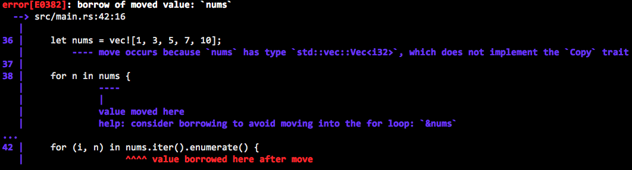
oh no I'm not good with computer what does this mean
let's try something.
Rust's compiler errors tend to be very verbose, but it's because it actually tries to help you fix the error!
let nums = vec![1, 3, 5, 7, 10];
for n in nums { println!("{}", n); }
for (i, n) in nums.iter().enumerate() {
println!("nums[{}] = {}", i, n);
}
following its help works here, and often does!
Notes:
- this is us running afoul of Rust's really cool ownership system.
- ownership encodes information about who is responsible for, or currently using, an object.
- but it can take some getting used to, so don't feel bad if you don't get it at first.
- many times, following the compiler's advice is enough to make it shut up about ownership and borrowing and moves.
[image: an example of a Rust compiler error, which not only gives the error message and location, but several more lines explaining the error, why it happened, and how to fix it]

Slide 34
What I want you to do!

Slide 35
For next class…
On the course info page, find the Rust Programming Language book.
follow along with chapters 1-3 to install and play around with Rust.
  Windows users, use PowerShell or WSL. cmd.exe is dead.
you're already programmers so a lot of things will be obvious to you!
try this: just read the code examples and if you're confused, read the text before it. that way you can skip the easy stuff.

